Slide 1
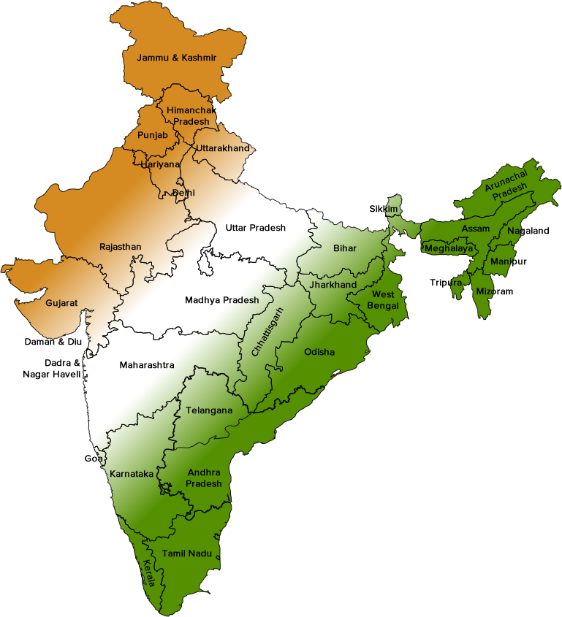
STATEWISE FINANCIAL ANALYSIS

Slide 2


PROJECT TEAM MEMBERS
PIYUSH RAMGIRWAR SUDARSHAN ATRE
( PD15_017 ) ANUSHA DUDDUKURU ( PD14_212 )
( PD15_130 )

Slide 3
Metrics for Financial Analysis
AGGREGATE EXPENDITURE
CAPITAL EXPENDITURE
GROSS FISCAL DEFICITS
NOMINAL GSDP SERIES
OWN TAX REVENUE
REVENUE EXPENDITURES
REVENUE DEFICITS
SOCIAL SECTOR EXPENDITURES

Slide 4
AGGREGATE EXPENDITURE
The aggregate expenditure is thus the sum total of all the expenditures undertaken in the economy by the factors during a given time period.
CAPITAL EXPENDITURE
Capital expenditure is the money spent by the government on the development of machinery, equipment, building, health facilities, education, etc.

Slide 5
GROSS FISCAL DEFICIT
The gross fiscal deficit (GFD) is the excess of total expenditure including loans net of recovery over revenue receipts (including external grants) and non-debt capital receipts.
NOMINAL GSDP
Nominal gross domestic product (GDP) is GDP given in current prices, without adjustment for inflation. Current price estimates of GDP are obtained by expressing values of all goods and services produced in the current reporting period.

Slide 6
OWN TAX REVENUE
SOTR includes revenues earned through – Sales Tax, State Excise duty, SGST, Land Revenue, Stamps & Registrations etc. Few states have other taxes relevant to their own state.
REVENUE DEFICITS
A revenue deficit occurs when realized net income is less than the projected net income. This happens when the actual amount of revenue and/or the actual amount of expenditures do not correspond with budgeted revenue and expenditures.

Slide 7
REVENUE EXPENDITURE
are short-term expenses used in the current period or typically within one year. Revenue expenditures include the expenses required to meet the ongoing operational costs of running a business, and thus are essentially the same as operating expenses (OPEX).
SOCIAL SECTOR EXPENDITURE
It includes expenditure on social services like rural development, food storage, warehouses, education, health and family welfare.

Slide 8
INSIGHTS
TOP STATES ACCORDING TO EACH FINANCIAL METRICS
CORELATION BETWEEN CAPITALEXPENDITURE AND GROSS FISCAL DEFICITS
CORELATION BETWEEN SOCIAL SECTOR EXPENDITURES AND TAX REVENUE
TOP10 STATES WITH HIGHEST GROSS
FISCAL DEFISITS

Slide 9
INSIGHTS
GROSS FISCAL DEFICITS TREND FOR
EACH STATES.
TOP 2 STATES AS PER UPWARD AND DOWNWARD TRENDS FOR GROSS FISCAL DEFICITS.
NOMINAL GSDP TREND FOR EACH STATES.
TOP 2 STATES AS PER UPWARD AND DOWNWARD TREND FORNOMINAL GSDP SERIES

Slide 10
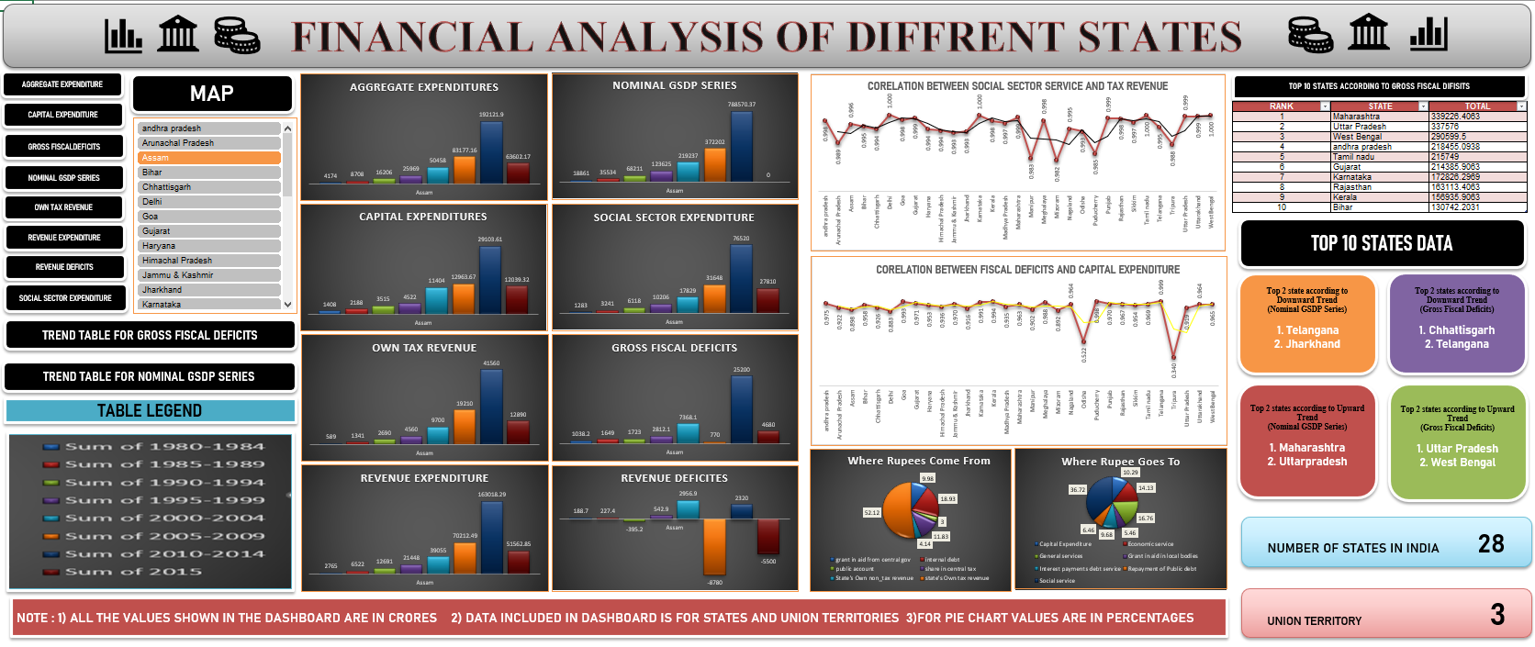
DASHBOARD

Slide 11
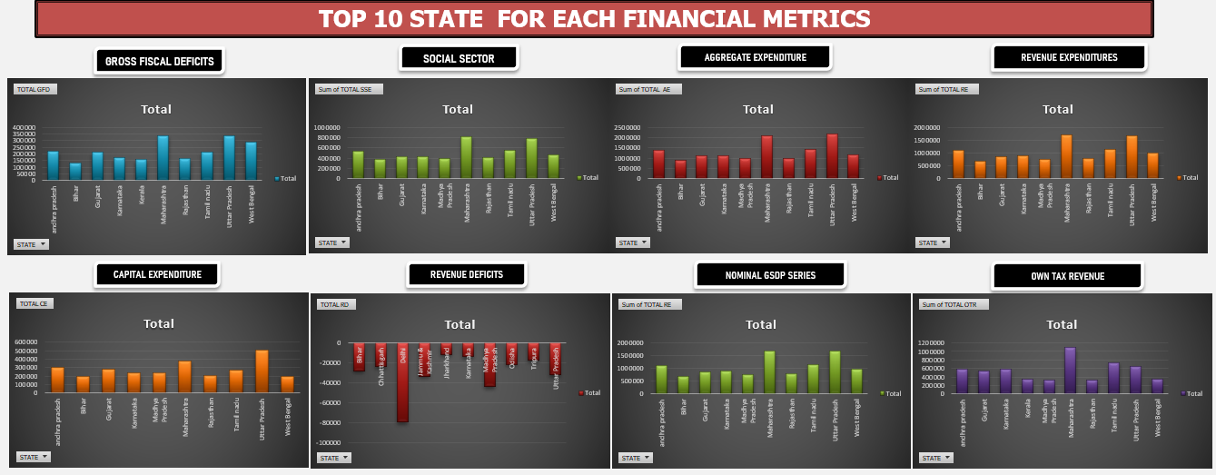
TOP 10 STATE FOR EACH METRICS

Slide 12
THANKS!
Any questions?

